Slide 1
Process Walk-through

Slide 2
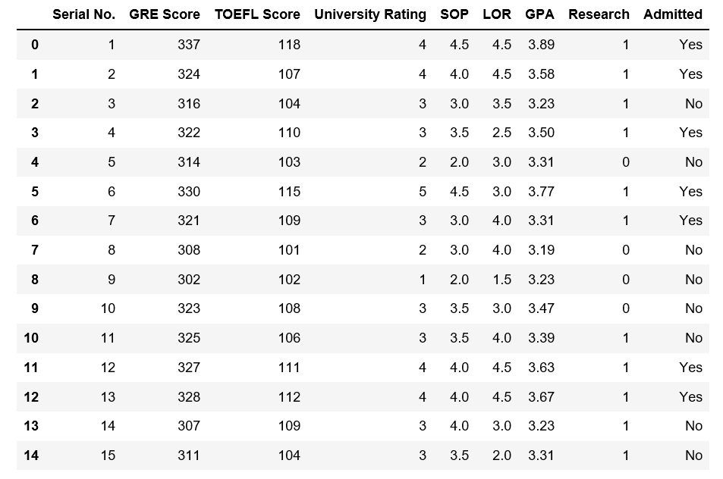

Slide 5
Exploratory Data Analysis

Slide 6
Describe

Slide 7
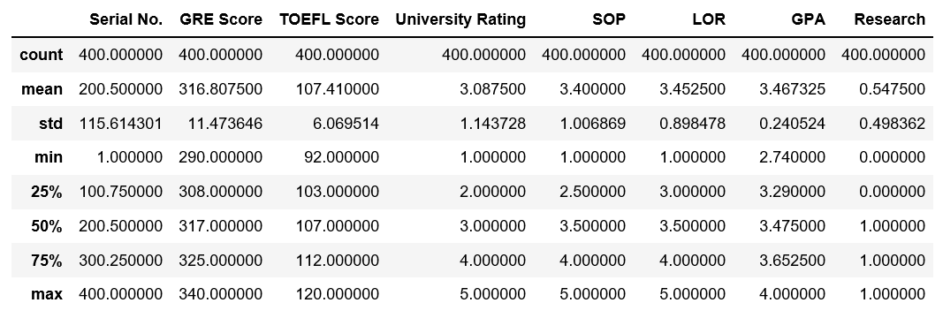
Explore Numerically

Slide 8
Santa Clara County Schools
 | Black pct | Asian pct | Hispnic pct | Mixed pct | White pct | Am.Ind pct | Filipino pct | Pac. Is. pct | Grad Pct | UCCSU ReqPct | DpOut Pct
count | 31 | 31 | 31 | 31 | 31 | 31 | 31 | 31 | 11 | 11 | 11
mean | 1.64 | 27.22 | 33.54 | 6.02 | 26.20 | 0.32 | 3.58 | 0.50 | 90.46 | 58.49 | 5.03
std | 1.07 | 18.26 | 23.73 | 3.54 | 20.15 | 0.40 | 3.93 | 0.46 | 5.98 | 15.27 | 4.74
min | 0.00 | 0.60 | 4.20 | 0.90 | 1.60 | 0.00 | 0.20 | 0.00 | 75.70 | 28.40 | 1.10
25% | 0.95 | 14.15 | 13.75 | 3.75 | 6.35 | 0.10 | 1.05 | 0.20 | 89.05 | 52.80 | 2.45
50% | 1.50 | 25.90 | 28.30 | 5.20 | 23.20 | 0.20 | 2.30 | 0.40 | 90.00 | 54.80 | 3.40
75% | 2.35 | 34.40 | 48.95 | 8.30 | 39.35 | 0.45 | 4.25 | 0.60 | 95.15 | 65.00 | 5.10
max | 4.80 | 73.60 | 91.90 | 14.90 | 72.90 | 2.20 | 17.70 | 2.40 | 97.10 | 81.60 | 17.80

Slide 9
Santa Clara County Schools
 | Black pct | Asian pct | Hispnic pct | Mixed pct | White pct | Am.Ind pct | Filipino pct | Pac. Is. pct | Grad Pct | UCCSU ReqPct | DpOut Pct
count | 31 | 31 | 31 | 31 | 31 | 31 | 31 | 31 | 11 | 11 | 11
mean | 1.64 | 27.22 | 33.54 | 6.02 | 26.20 | 0.32 | 3.58 | 0.50 | 90.46 | 58.49 | 5.03
std | 1.07 | 18.26 | 23.73 | 3.54 | 20.15 | 0.40 | 3.93 | 0.46 | 5.98 | 15.27 | 4.74
min | 0.00 | 0.60 | 4.20 | 0.90 | 1.60 | 0.00 | 0.20 | 0.00 | 75.70 | 28.40 | 1.10
25% | 0.95 | 14.15 | 13.75 | 3.75 | 6.35 | 0.10 | 1.05 | 0.20 | 89.05 | 52.80 | 2.45
50% | 1.50 | 25.90 | 28.30 | 5.20 | 23.20 | 0.20 | 2.30 | 0.40 | 90.00 | 54.80 | 3.40
75% | 2.35 | 34.40 | 48.95 | 8.30 | 39.35 | 0.45 | 4.25 | 0.60 | 95.15 | 65.00 | 5.10
max | 4.80 | 73.60 | 91.90 | 14.90 | 72.90 | 2.20 | 17.70 | 2.40 | 97.10 | 81.60 | 17.80

Slide 10
Santa Clara County Schools
 | Black pct | Asian pct | Hispnic pct | Mixed pct | White pct | Am.Ind pct | Filipino pct | Pac. Is. pct | Grad Pct | UCCSU ReqPct | DpOut Pct
count | 31 | 31 | 31 | 31 | 31 | 31 | 31 | 31 | 11 | 11 | 11
mean | 1.64 | 27.22 | 33.54 | 6.02 | 26.20 | 0.32 | 3.58 | 0.50 | 90.46 | 58.49 | 5.03
std | 1.07 | 18.26 | 23.73 | 3.54 | 20.15 | 0.40 | 3.93 | 0.46 | 5.98 | 15.27 | 4.74
min | 0.00 | 0.60 | 4.20 | 0.90 | 1.60 | 0.00 | 0.20 | 0.00 | 75.70 | 28.40 | 1.10
25% | 0.95 | 14.15 | 13.75 | 3.75 | 6.35 | 0.10 | 1.05 | 0.20 | 89.05 | 52.80 | 2.45
50% | 1.50 | 25.90 | 28.30 | 5.20 | 23.20 | 0.20 | 2.30 | 0.40 | 90.00 | 54.80 | 3.40
75% | 2.35 | 34.40 | 48.95 | 8.30 | 39.35 | 0.45 | 4.25 | 0.60 | 95.15 | 65.00 | 5.10
max | 4.80 | 73.60 | 91.90 | 14.90 | 72.90 | 2.20 | 17.70 | 2.40 | 97.10 | 81.60 | 17.80

Slide 11
Santa Clara County Schools
 | Black pct | Asian pct | Hispnic pct | Mixed pct | White pct | Am.Ind pct | Filipino pct | Pac. Is. pct | Grad Pct | UCCSU ReqPct | DpOut Pct
count | 31 | 31 | 31 | 31 | 31 | 31 | 31 | 31 | 11 | 11 | 11
mean | 1.64 | 27.22 | 33.54 | 6.02 | 26.20 | 0.32 | 3.58 | 0.50 | 90.46 | 58.49 | 5.03
std | 1.07 | 18.26 | 23.73 | 3.54 | 20.15 | 0.40 | 3.93 | 0.46 | 5.98 | 15.27 | 4.74
min | 0.00 | 0.60 | 4.20 | 0.90 | 1.60 | 0.00 | 0.20 | 0.00 | 75.70 | 28.40 | 1.10
25% | 0.95 | 14.15 | 13.75 | 3.75 | 6.35 | 0.10 | 1.05 | 0.20 | 89.05 | 52.80 | 2.45
50% | 1.50 | 25.90 | 28.30 | 5.20 | 23.20 | 0.20 | 2.30 | 0.40 | 90.00 | 54.80 | 3.40
75% | 2.35 | 34.40 | 48.95 | 8.30 | 39.35 | 0.45 | 4.25 | 0.60 | 95.15 | 65.00 | 5.10
max | 4.80 | 73.60 | 91.90 | 14.90 | 72.90 | 2.20 | 17.70 | 2.40 | 97.10 | 81.60 | 17.80

Slide 12
Santa Clara County Schools
 | Black pct | Asian pct | Hispnic pct | Mixed pct | White pct | Am.Ind pct | Filipino pct | Pac. Is. pct | Grad Pct | UCCSU ReqPct | DpOut Pct
count | 31 | 31 | 31 | 31 | 31 | 31 | 31 | 31 | 11 | 11 | 11
mean | 1.64 | 27.22 | 33.54 | 6.02 | 26.20 | 0.32 | 3.58 | 0.50 | 90.46 | 58.49 | 5.03
std | 1.07 | 18.26 | 23.73 | 3.54 | 20.15 | 0.40 | 3.93 | 0.46 | 5.98 | 15.27 | 4.74
min | 0.00 | 0.60 | 4.20 | 0.90 | 1.60 | 0.00 | 0.20 | 0.00 | 75.70 | 28.40 | 1.10
25% | 0.95 | 14.15 | 13.75 | 3.75 | 6.35 | 0.10 | 1.05 | 0.20 | 89.05 | 52.80 | 2.45
50% | 1.50 | 25.90 | 28.30 | 5.20 | 23.20 | 0.20 | 2.30 | 0.40 | 90.00 | 54.80 | 3.40
75% | 2.35 | 34.40 | 48.95 | 8.30 | 39.35 | 0.45 | 4.25 | 0.60 | 95.15 | 65.00 | 5.10
max | 4.80 | 73.60 | 91.90 | 14.90 | 72.90 | 2.20 | 17.70 | 2.40 | 97.10 | 81.60 | 17.80

Slide 13
Santa Clara County Schools
 | Black pct | Asian pct | Hispnic pct | Mixed pct | White pct | Am.Ind pct | Filipino pct | Pac. Is. pct | Grad Pct | UCCSU ReqPct | DpOut Pct
count | 31 | 31 | 31 | 31 | 31 | 31 | 31 | 31 | 11 | 11 | 11
mean | 1.64 | 27.22 | 33.54 | 6.02 | 26.20 | 0.32 | 3.58 | 0.50 | 90.46 | 58.49 | 5.03
std | 1.07 | 18.26 | 23.73 | 3.54 | 20.15 | 0.40 | 3.93 | 0.46 | 5.98 | 15.27 | 4.74
min | 0.00 | 0.60 | 4.20 | 0.90 | 1.60 | 0.00 | 0.20 | 0.00 | 75.70 | 28.40 | 1.10
25% | 0.95 | 14.15 | 13.75 | 3.75 | 6.35 | 0.10 | 1.05 | 0.20 | 89.05 | 52.80 | 2.45
50% | 1.50 | 25.90 | 28.30 | 5.20 | 23.20 | 0.20 | 2.30 | 0.40 | 90.00 | 54.80 | 3.40
75% | 2.35 | 34.40 | 48.95 | 8.30 | 39.35 | 0.45 | 4.25 | 0.60 | 95.15 | 65.00 | 5.10
max | 4.80 | 73.60 | 91.90 | 14.90 | 72.90 | 2.20 | 17.70 | 2.40 | 97.10 | 81.60 | 17.80

Slide 14
Santa Clara County Schools
 | Black pct | Asian pct | Hispnic pct | Mixed pct | White pct | Am.Ind pct | Filipino pct | Pac. Is. pct | Grad Pct | UCCSU ReqPct | DpOut Pct
count | 31 | 31 | 31 | 31 | 31 | 31 | 31 | 31 | 11 | 11 | 11
mean | 1.64 | 27.22 | 33.54 | 6.02 | 26.20 | 0.32 | 3.58 | 0.50 | 90.46 | 58.49 | 5.03
std | 1.07 | 18.26 | 23.73 | 3.54 | 20.15 | 0.40 | 3.93 | 0.46 | 5.98 | 15.27 | 4.74
min | 0.00 | 0.60 | 4.20 | 0.90 | 1.60 | 0.00 | 0.20 | 0.00 | 75.70 | 28.40 | 1.10
25% | 0.95 | 14.15 | 13.75 | 3.75 | 6.35 | 0.10 | 1.05 | 0.20 | 89.05 | 52.80 | 2.45
50% | 1.50 | 25.90 | 28.30 | 5.20 | 23.20 | 0.20 | 2.30 | 0.40 | 90.00 | 54.80 | 3.40
75% | 2.35 | 34.40 | 48.95 | 8.30 | 39.35 | 0.45 | 4.25 | 0.60 | 95.15 | 65.00 | 5.10
max | 4.80 | 73.60 | 91.90 | 14.90 | 72.90 | 2.20 | 17.70 | 2.40 | 97.10 | 81.60 | 17.80

Slide 15
Santa Clara County Schools
 | Black pct | Asian pct | Hispnic pct | Mixed pct | White pct | Am.Ind pct | Filipino pct | Pac. Is. pct | Grad Pct | UCCSU ReqPct | DpOut Pct
count | 31 | 31 | 31 | 31 | 31 | 31 | 31 | 31 | 11 | 11 | 11
mean | 1.64 | 27.22 | 33.54 | 6.02 | 26.20 | 0.32 | 3.58 | 0.50 | 90.46 | 58.49 | 5.03
std | 1.07 | 18.26 | 23.73 | 3.54 | 20.15 | 0.40 | 3.93 | 0.46 | 5.98 | 15.27 | 4.74
min | 0.00 | 0.60 | 4.20 | 0.90 | 1.60 | 0.00 | 0.20 | 0.00 | 75.70 | 28.40 | 1.10
25% | 0.95 | 14.15 | 13.75 | 3.75 | 6.35 | 0.10 | 1.05 | 0.20 | 89.05 | 52.80 | 2.45
50% | 1.50 | 25.90 | 28.30 | 5.20 | 23.20 | 0.20 | 2.30 | 0.40 | 90.00 | 54.80 | 3.40
75% | 2.35 | 34.40 | 48.95 | 8.30 | 39.35 | 0.45 | 4.25 | 0.60 | 95.15 | 65.00 | 5.10
max | 4.80 | 73.60 | 91.90 | 14.90 | 72.90 | 2.20 | 17.70 | 2.40 | 97.10 | 81.60 | 17.80

Slide 16
Santa Clara County Schools
 | Black pct | Asian pct | Hispnic pct | Mixed pct | White pct | Am.Ind pct | Filipino pct | Pac. Is. pct | Grad Pct | UCCSU ReqPct | DpOut Pct
count | 31 | 31 | 31 | 31 | 31 | 31 | 31 | 31 | 11 | 11 | 11
mean | 1.64 | 27.22 | 33.54 | 6.02 | 26.20 | 0.32 | 3.58 | 0.50 | 90.46 | 58.49 | 5.03
std | 1.07 | 18.26 | 23.73 | 3.54 | 20.15 | 0.40 | 3.93 | 0.46 | 5.98 | 15.27 | 4.74
min | 0.00 | 0.60 | 4.20 | 0.90 | 1.60 | 0.00 | 0.20 | 0.00 | 75.70 | 28.40 | 1.10
25% | 0.95 | 14.15 | 13.75 | 3.75 | 6.35 | 0.10 | 1.05 | 0.20 | 89.05 | 52.80 | 2.45
50% | 1.50 | 25.90 | 28.30 | 5.20 | 23.20 | 0.20 | 2.30 | 0.40 | 90.00 | 54.80 | 3.40
75% | 2.35 | 34.40 | 48.95 | 8.30 | 39.35 | 0.45 | 4.25 | 0.60 | 95.15 | 65.00 | 5.10
max | 4.80 | 73.60 | 91.90 | 14.90 | 72.90 | 2.20 | 17.70 | 2.40 | 97.10 | 81.60 | 17.80

Slide 17
Santa Clara County Schools
 | Black pct | Asian pct | Hispnic pct | Mixed pct | White pct | Am.Ind pct | Filipino pct | Pac. Is. pct | Grad Pct | UCCSU ReqPct | DpOut Pct
count | 31 | 31 | 31 | 31 | 31 | 31 | 31 | 31 | 11 | 11 | 11
mean | 1.64 | 27.22 | 33.54 | 6.02 | 26.20 | 0.32 | 3.58 | 0.50 | 90.46 | 58.49 | 5.03
std | 1.07 | 18.26 | 23.73 | 3.54 | 20.15 | 0.40 | 3.93 | 0.46 | 5.98 | 15.27 | 4.74
min | 0.00 | 0.60 | 4.20 | 0.90 | 1.60 | 0.00 | 0.20 | 0.00 | 75.70 | 28.40 | 1.10
25% | 0.95 | 14.15 | 13.75 | 3.75 | 6.35 | 0.10 | 1.05 | 0.20 | 89.05 | 52.80 | 2.45
50% | 1.50 | 25.90 | 28.30 | 5.20 | 23.20 | 0.20 | 2.30 | 0.40 | 90.00 | 54.80 | 3.40
75% | 2.35 | 34.40 | 48.95 | 8.30 | 39.35 | 0.45 | 4.25 | 0.60 | 95.15 | 65.00 | 5.10
max | 4.80 | 73.60 | 91.90 | 14.90 | 72.90 | 2.20 | 17.70 | 2.40 | 97.10 | 81.60 | 17.80

Slide 18
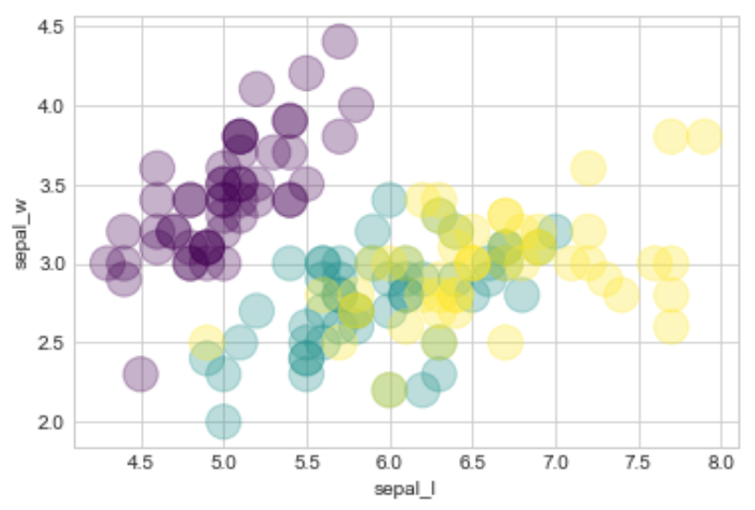
Explore Visually

Slide 19
Clean the Data

Slide 20
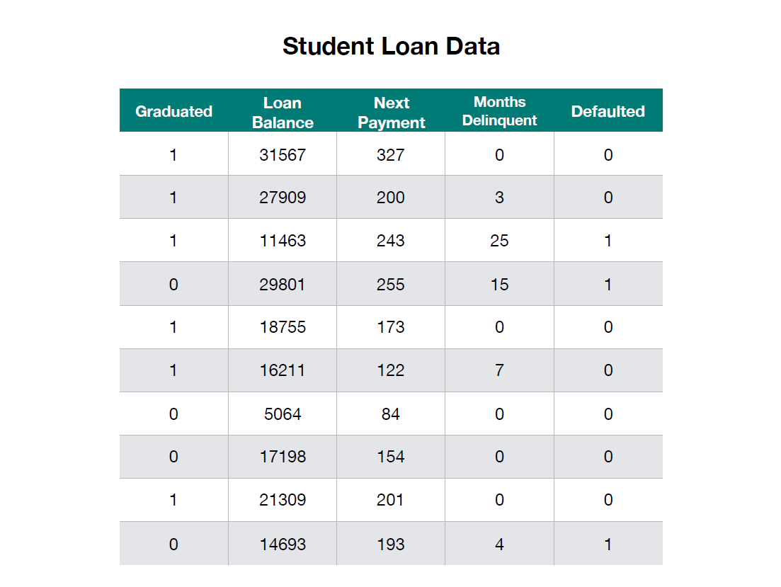
Dataset

Slide 21
Data Transformation

Slide 22
Categorical to Binary Encoding

Slide 23
Categorical to Binary Encoding
Gender
Female
Male
Female
Female
Male
Male
Female
Gender
1
0
1
1
0
0
1

Slide 24
One-hot Encoding

Slide 25
One-hot Encoding
Race
Asian
Black
White
Pacific Islander
American Indian
White
Black
American Indian | Asian | Black | Pacific Islander | White
0 | 1 | 0 | 0 | 0
0 | 0 | 1 | 0 | 0
0 | 0 | 0 | 0 | 1
0 | 0 | 0 | 1 | 0
1 | 0 | 0 | 0 | 0
0 | 0 | 0 | 0 | 1
0 | 0 | 1 | 0 | 0

Slide 26
Put the features into X
Put the target into y

Slide 27
Dataset

Slide 28
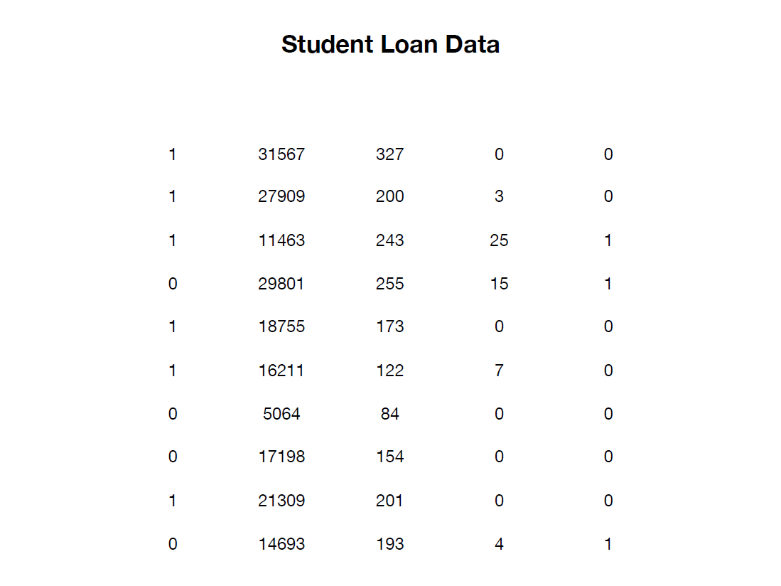
Dataset

Slide 29
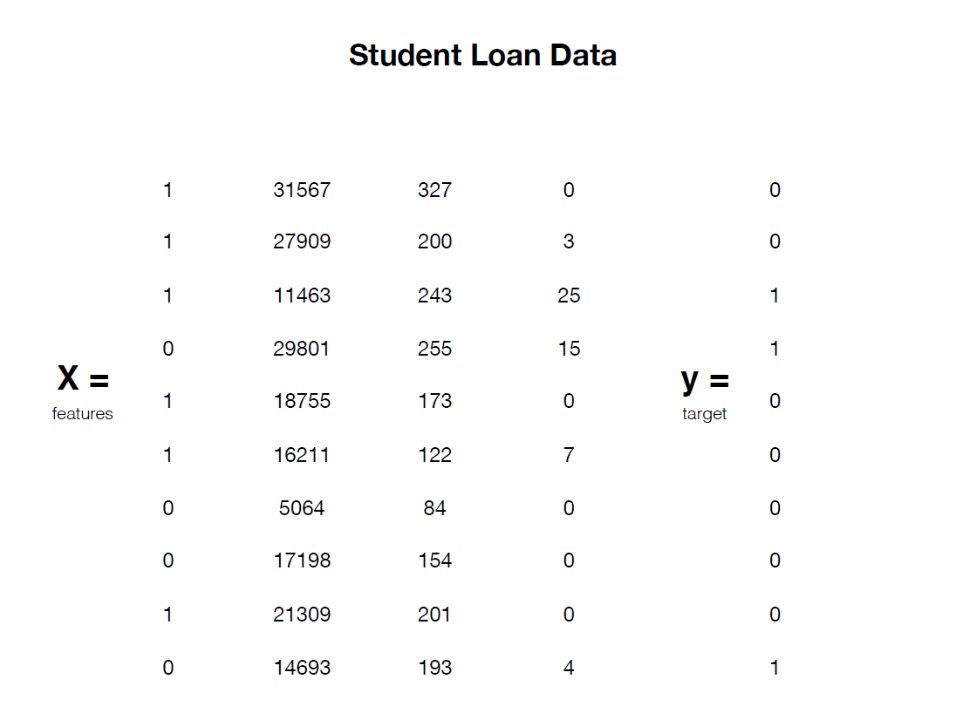
Dataset

Slide 30

Training a Model
Data Set

Slide 31
Split the Data
Training Data
Test Data

Slide 32
Split the Data
Training Data
Test Data
X_train, y_train X_test, y_test

Slide 33
Scaling

Slide 34
Normalizing
(Min-Max scaling)
Standardizing
(z-score)
x – min(X)
max(X) - min(X)
x – mean(X)
std(X)
z =

Slide 35
Normalizing
(Min-Max scaling)
Standardizing
(Z-score)
x – min(X)
max(X) - min(X)
x – mean(X)
std(X)
z =
Values between:
0 and 1

Slide 36
Normalizing
(Min-Max scaling)
Standardizing
(Z-score)
x – min(X)
max(X) - min(X)
x – mean(X)
std(X)
z =
Values between:
0 and 1
Values primarily between:
-3 and 3

Slide 37
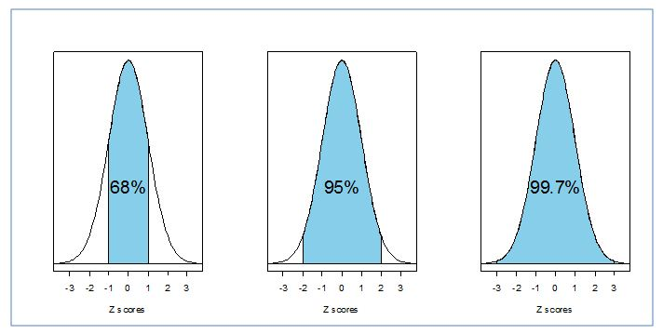
Empirical Rule

Slide 38
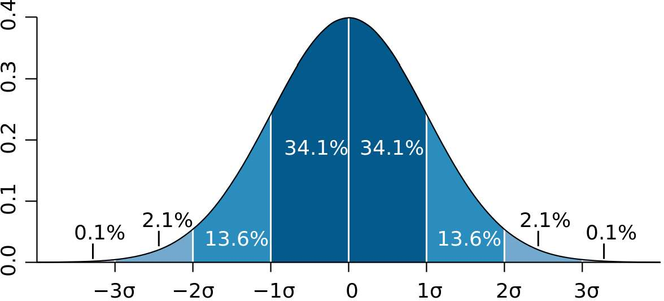
Standardize the Data

Slide 39
Standardize the Data
x - mean
z-score =
std

Slide 40
Standardize the Data
5’10 - mean
z-score =
std

Slide 41
Standardize the Data
5’10 – 5’6
z-score =
std

Slide 42
Standardize the Data
5’10 – 5’6
z-score =
2”

Slide 43
Standardize the Data
4”
z-score =
2”

Slide 44
Standardize the Data
4”
2 =
2”

Slide 45
Model the Data

Slide 46
Scikit-learn

Slide 47
Scikit-learn
Model.fit(X_train,y_train)
Model.predict(X_test)
Model.score(X_test,y_test)

Slide 48


Model.fit(X_train,y_train)
TRAIN DATA
ALGORITHM
MODEL

Slide 49
Common ML Algorithms
Linear Regression
Logistic Regression
Support Vector Machine
Decision Tree
K-Nearest Neighbor
=

Slide 50
Model. predict(X_test)
Prediction
0
1
0
0
1
0
TEST DATA
MODEL

Slide 51
Model. score(X_test)
Prediction | Label
0 | 1
1 | 1
0 | 0
0 | 1
1 | 0
0 | 0
Prediction
0
1
0
0
1
0
TEST DATA
MODEL

Slide 52
Train

Slide 53
Train
Test

Slide 54
Train
Test
Deploy

